Slide 1


ADMIS Lab
先进数据与机器智能系统实验室
Query Optimization
Chapter 16
Yichao Zhang
Email: yichaozhang@tongji.edu.cn
Department of Computer Science and Technology
Tongji University

Slide 2
Outline
概述
关系表达式的转换
表达式执行代价估计
执行计划选择
物化视图*
查询优化中的高级话题*

Slide 3
Introduction
Alternative ways of executing (执行) a given query
  Equivalent expressions
  Different algorithms for each operation
Cost difference between a good way and a bad way of executing a query can be enormous
Estimate the cost of operations
  Depend on the statistical information about relations which the database should maintain
  Need to estimate the statistics for intermediate results to compute the cost of complex expressions

Slide 4
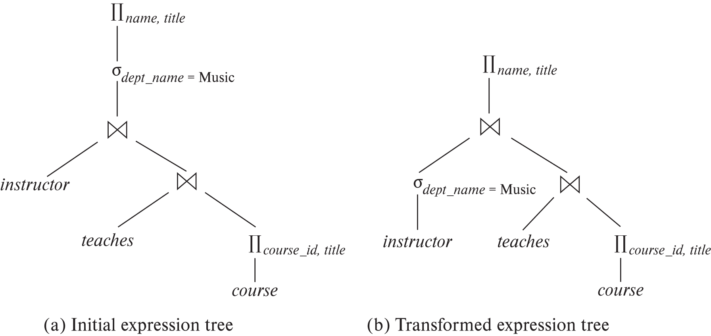
Introduction (Cont.)
查询：找出Music系所有教师的名字以及每位教师所教授课程的名称

Slide 5
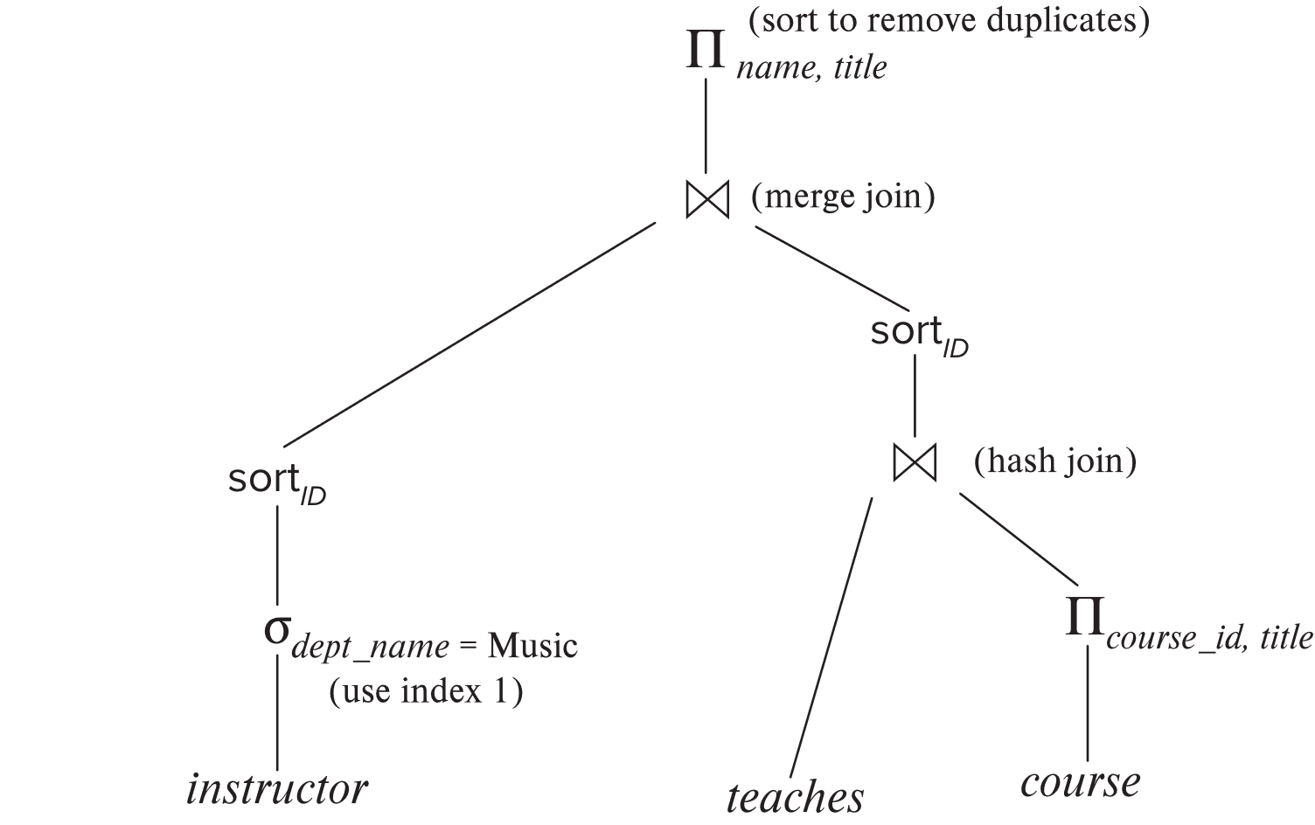
Introduction (Cont.)
执行计划需明确每个运算使用的算法以及运算之间的执行如何协调

Slide 6
Introduction (Cont.)
产生最优查询执行计划的三个步骤(Cost-based Optimization，基于代价的优化）
  步骤1：产生逻辑上与给定表达式等价的表达式
    使用等价规则
  步骤2：对所产生的表达式以不同方式标注，产生不同的查询执行计划
  步骤3：估计每个执行计划的代价，选择估计代价最小的执行计划

Slide 7
Outline
概述
关系表达式的转换
表达式执行代价估计
执行计划选择
物化视图*
查询优化中的高级话题*

Slide 8
关系表达式转换
Equivalence of two relational algebra expressions
  Generate the same set of tuples on every legal database instance
  Note: the order of tuples is irrelevant
Equivalence rule (等价规则)
  The expressions of two forms are equivalent
  Can replace expression of first form by the second, or vice versa

Slide 9
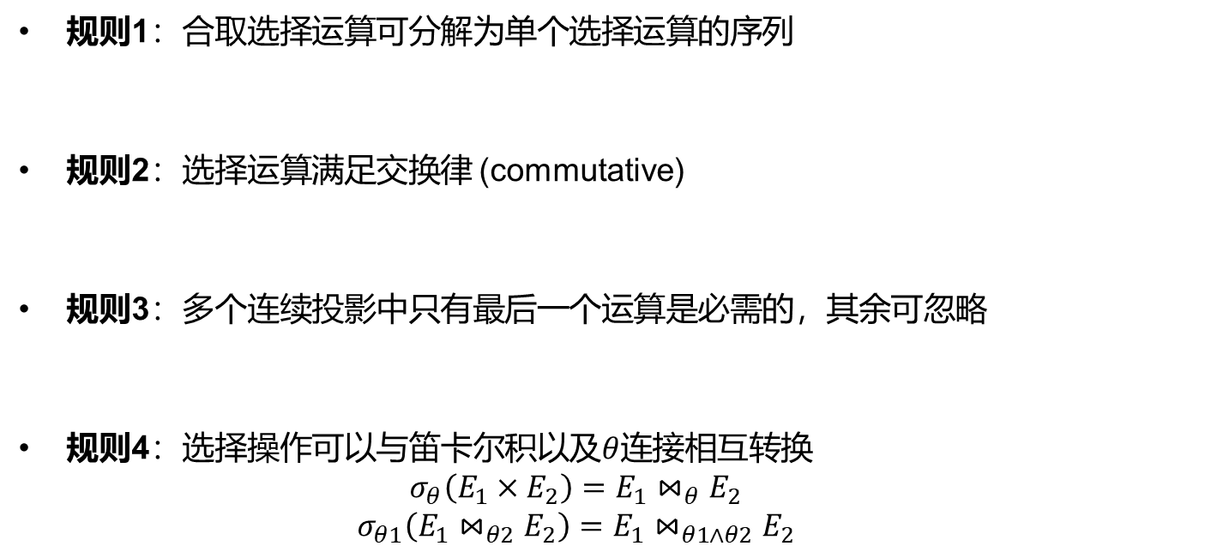
Equivalence Rules
规则1：合取选择运算可分解为单个选择运算的序列
规则2：选择运算满足交换律 (commutative)
规则3：多个连续投影中只有最后一个运算是必需的，其余可忽略
规则4：选择操作可以与笛卡尔积以及$θ$连接相互转换
  $$σ_{θ}\left(E_{1}×E_{2}\right)=E_{1}⋈_{θ}E_{2}$$
  $$σ_{θ1}\left(E_{1}⋈_{θ2}E_{2}\right)=E_{1}⋈_{θ1∧θ2}E_{2}$$

Slide 10
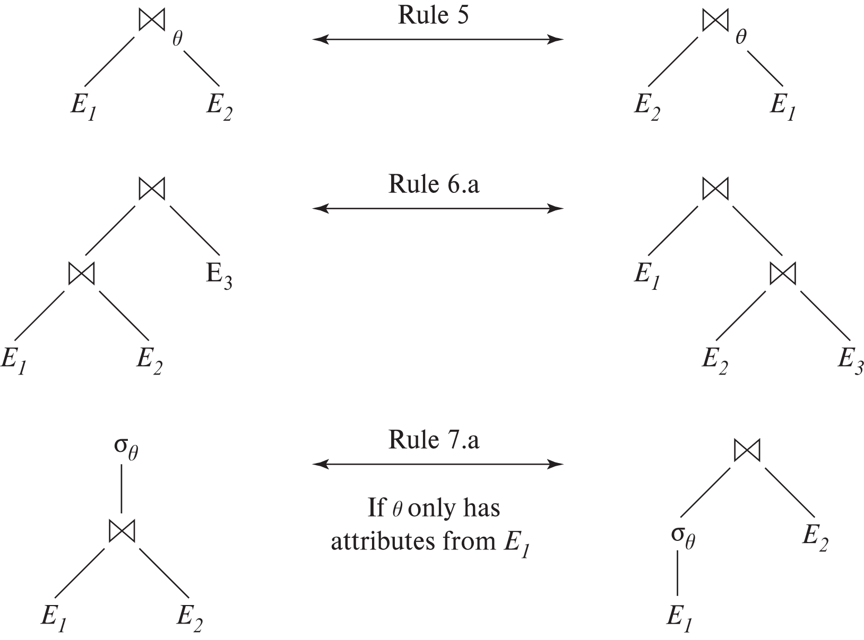
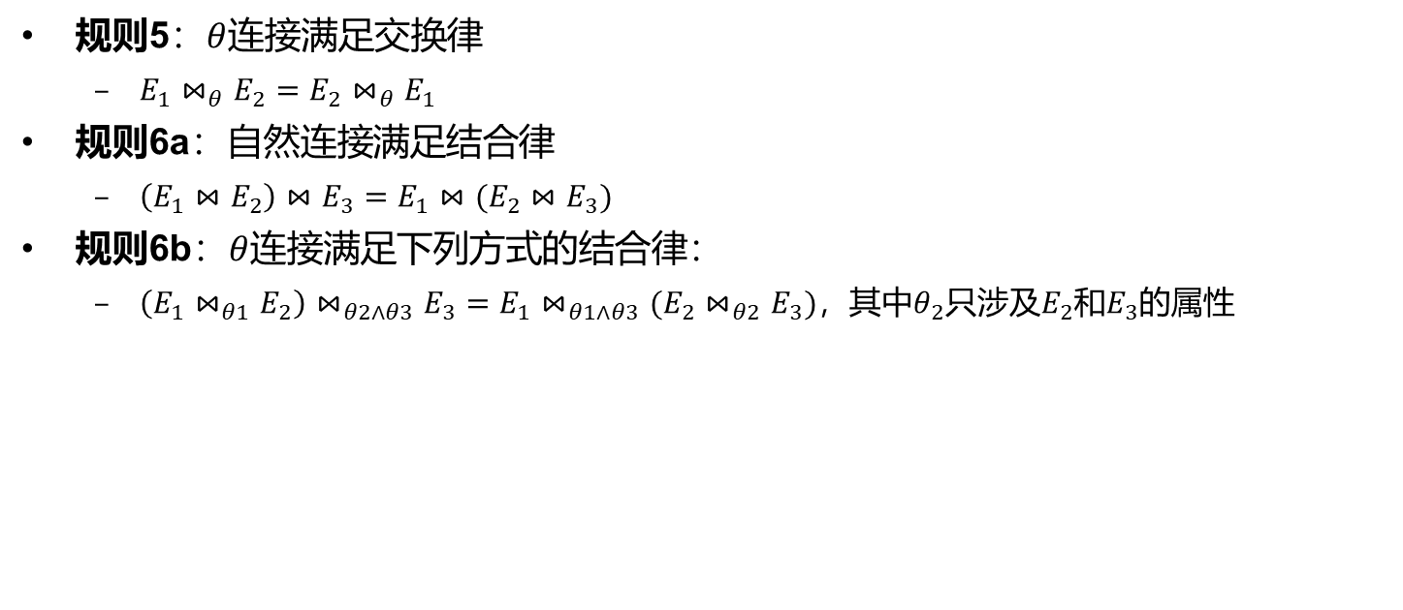
Equivalence Rules (Cont.)
规则5：$θ$连接满足交换律
  $E_{1}⋈_{θ}E_{2}=E_{2}⋈_{θ}E_{1}$
规则6a：自然连接满足结合律
  $\left(E_{1}⋈E_{2}\right)⋈E_{3}=E_{1}⋈(E_{2}⋈E_{3})$
规则6b：$θ$连接满足下列方式的结合律：
  $\left(E_{1}⋈_{θ1}E_{2}\right)⋈_{θ2∧θ3}E_{3}=E_{1}⋈_{θ1∧θ3}(E_{2}⋈_{θ2}E_{3})$，其中$θ_{2}$只涉及$E_{2}$和$E_{3}$的属性

Slide 11

Equivalence Rules (Cont.)
规则7：选择操作在下面两个条件下对$θ$连接满足分配律
  a. 当选择条件$θ_{0}$中的所有属性只涉及参与连接的表达式之一(如$E_{1}$)时：
  $$σ_{θ_{0}}\left(E_{1}⋈_{θ}E_{2}\right)=(σ_{θ_{0}}(E_{1}))⋈_{θ}E_{2}$$
  b. 当选择条件$θ_{1}$只涉及$E_{1}$的属性，选择条件$θ_{2}$只涉及$E_{2}$的属性时：
  $$σ_{θ_{1}∧θ_{2}}\left(E_{1}⋈_{θ}E_{2}\right)=(σ_{θ_{1}}(E_{1}))⋈_{θ}(σ_{θ_{2}}{(E}_{2}))$$

Slide 12
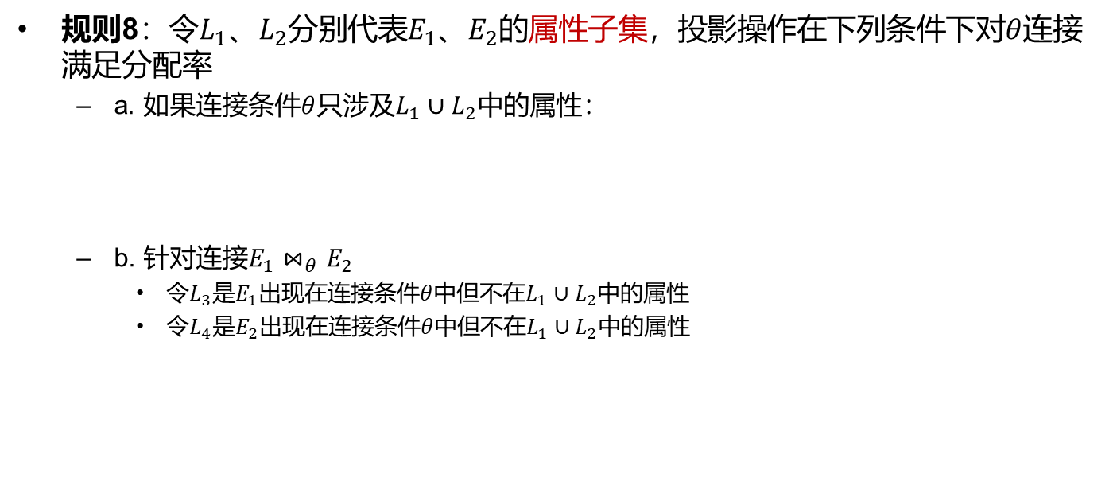
Equivalence Rules (Cont.)
规则8：令$L_{1}$、$L_{2}$分别代表$E_{1}$、$E_{2}$的属性子集，投影操作在下列条件下对$θ$连接满足分配率
  a. 如果连接条件$θ$只涉及$L_{1}∪L_{2}$中的属性：
  b. 针对连接$E_{1}⋈_{θ}E_{2}$
    令$L_{3}$是$E_{1}$出现在连接条件$θ$中但不在$L_{1}∪L_{2}$中的属性
    令$L_{4}$是$E_{2}$出现在连接条件$θ$中但不在$L_{1}∪L_{2}$中的属性

Slide 13
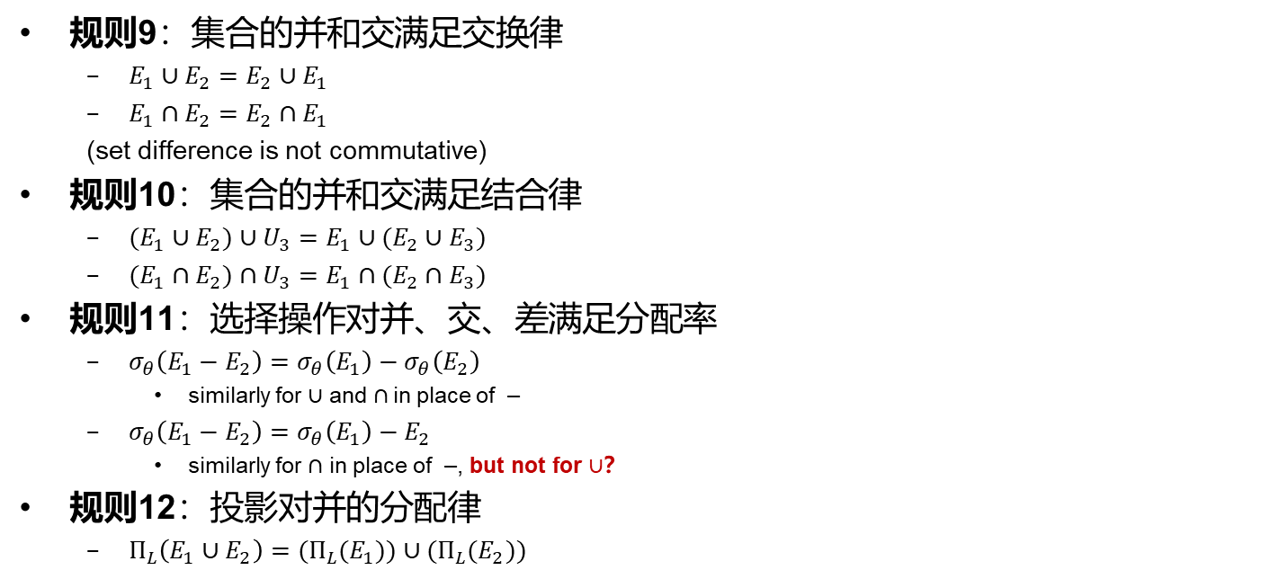
Equivalence Rules (Cont.)
规则9：集合的并和交满足交换律
  $E_{1}∪E_{2}=E_{2}∪E_{1}$
  $E_{1}∩E_{2}=E_{2}∩E_{1}$
  (set difference is not commutative)
规则10：集合的并和交满足结合律
  $(E_{1}∪E_{2})∪U_{3}=E_{1}∪(E_{2}∪E_{3})$
  $(E_{1}∩E_{2})∩U_{3}=E_{1}∩(E_{2}∩E_{3})$
规则11：选择操作对并、交、差满足分配率
  $σ_{θ}\left(E_{1}−E_{2}\right)=σ_{θ}\left(E_{1}\right)−σ_{θ}\left(E_{2}\right)$
    similarly for $∪$ and $∩$in place of –
  $σ_{θ}\left(E_{1}−E_{2}\right)=σ_{θ}\left(E_{1}\right)−E_{2}$
    similarly for $∩$ in place of –, but not for $∪$？
规则12：投影对并的分配律
  $Π_{L}\left(E_{1}∪E_{2}\right)=(Π_{L}(E_{1}))∪(Π_{L}(E_{2}))$

Slide 14
Example 1: Pushing Selections
Find the names of all instructors in Music department, along with the titles of the courses that they teach
  Π_{name, title}(σ_{dept_name= ‘Music’}(instructor ⨝ (teaches ⨝ Π_{course_id, title} (course))))
Transformation using rule 7a
  Π_{name, title}((σ_{dept_name= ‘Music’}(instructor)) ⨝ (teaches ⨝ Π_{course_id, title} (course)))

Slide 15
Example 2: Multiple Transformations
Find the names of all instructors in Music department who have taught a course in 2021, along with the titles of the courses that they taught
  Π_{name, title}(σ_{dept_name= "Music”∧year = 2021}(instructor ⨝ (teaches ⨝ Π_{course_id, title} (course))))
Rule 6a:
  Π_{name, title}(σ_{dept_name= “Music”∧year = 2021}((instructor ⨝ teaches) ⨝ Π_{course_id, title} (course)))
Rule 7a:
Π_{name, title}((σ_{dept_name= “Music”∧year = 2021}(instructor ⨝ teaches)) ⨝ Π_{course_id, title} (course))
Rule1 & 7a:
Π_{name, title}((σ_{dept_name= “Music”} (instructor) ⨝ σ_{year = 2021} (teaches)) ⨝ Π_{course_id, title} (course))

Slide 16
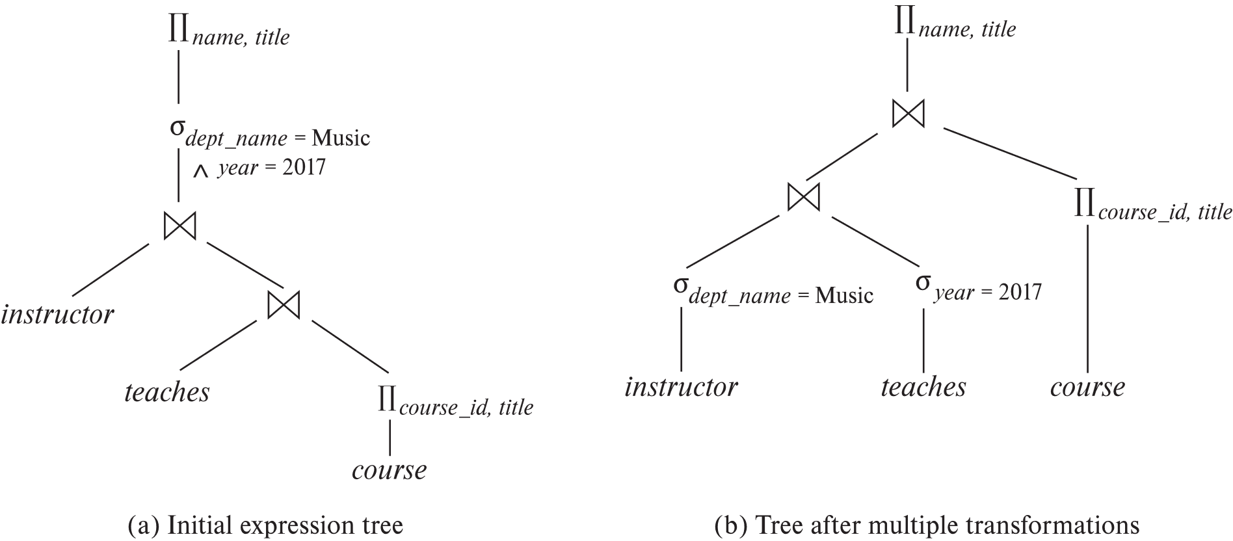
Example 2: Multiple Transformations

Slide 17
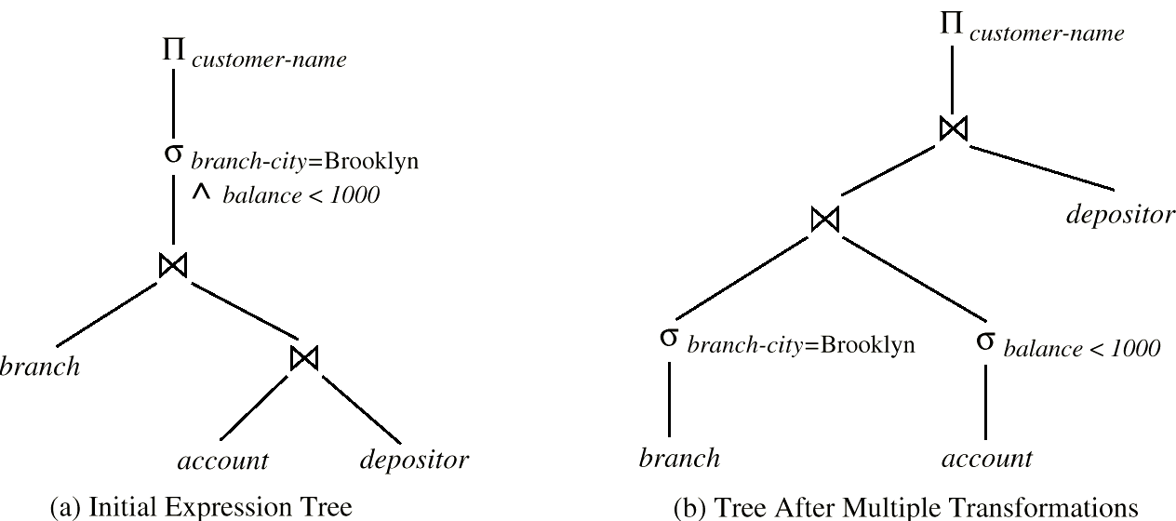
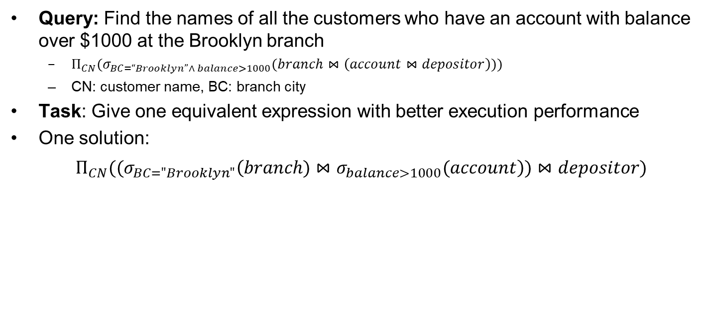
Exercise
Query: Find the names of all the customers who have an account with balance over $1000 at the Brooklyn branch
  $Π_{CN}(σ_{BC=“Brooklyn”∧ balance>1000}(branch⋈\left(account⋈depositor\right)))$
  CN: customer name, BC: branch city
Task: Give one equivalent expression with better execution performance
One solution:
$Π_{CN}((σ_{BC="Brooklyn"}\left(branch)⋈σ_{balance>1000}(account\right))⋈depositor)$

Slide 18

Join Ordering
For three relations $r_{1}$, $r_{2}$, and $r_{3}$,
$$\left(r_{1}⋈r_{2}\right)⋈r_{3}=r_{1}⋈(r_{2}⋈r_{3})$$
If $r_{2}⋈r_{3}$ is quite large and $r_{1}⋈r_{2}$ is small, we choose
$$\left(r_{1}⋈r_{2}\right)⋈r_{3}$$
so that we can compute and store a smaller temporary relation

Slide 19
Join Ordering (Cont.)
Consider the expression
Π_{name, title}(σ_{dept_name= “Music”} (instructor) ⨝ teaches) ⨝ Π_{course_id, title} (course))))
Solution A
  compute teaches ⨝ Π_{course_id, title} (course) first, and join the result with σ_{dept_name= “Music”} (instructor)
  the result of the first join is likely to be a large relation
Solution B
  compute σ_{dept_name= “Music”} (instructor) ⨝ teaches first
  only a small fraction of instructors are likely to be from the Music department

Slide 20
Outline
概述
关系表达式的转换
表达式执行代价估计
执行计划选择
物化视图*
查询优化中的高级话题*

Slide 21
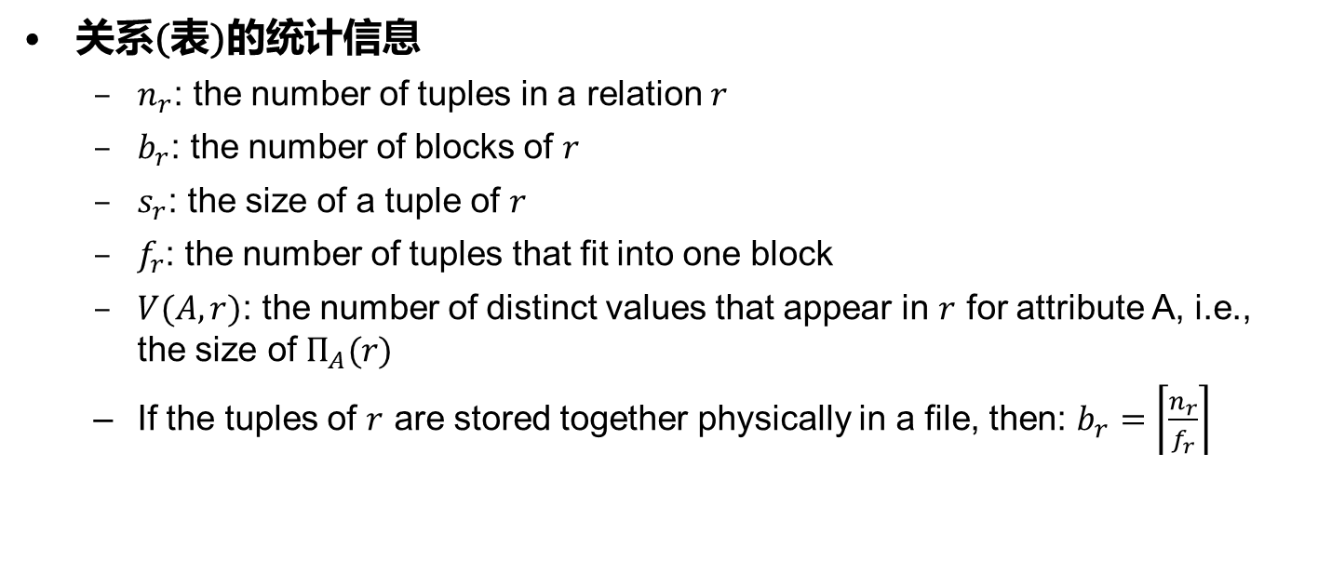
Statistical Information for Relation
关系(表)的统计信息
  $n_{r}$: the number of tuples in a relation $r$
  $b_{r}$: the number of blocks of $r$
  $s_{r}$: the size of a tuple of $r$
  $f_{r}$: the number of tuples that fit into one block
  $V(A,r)$: the number of distinct values that appear in $r$ for attribute A, i.e., the size of $Π_{A}(r)$
  If the tuples of $r$ are stored together physically in a file, then: $b_{r}=\left\lceil \frac{n_{r}}{f_{r}}\right\rceil$

Slide 22
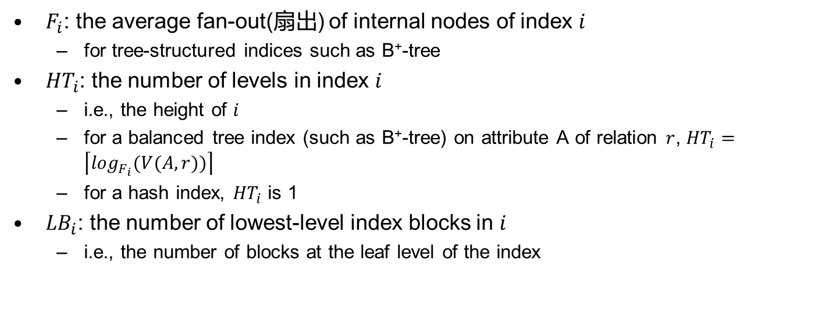
Catalog Information about Indices
$F_{i}$: the average fan-out(扇出) of internal nodes of index $i$
  for tree-structured indices such as B⁺-tree
${HT}_{i}$: the number of levels in index $i$
  i.e., the height of $i$
  for a balanced tree index (such as B⁺-tree) on attribute A of relation $r$, ${HT}_{i}=\left\lceil \log_{F_{i}}(V(A,r))\right\rceil$
  for a hash index, ${HT}_{i}$ is 1
${LB}_{i}$: the number of lowest-level index blocks in $i$
  i.e., the number of blocks at the leaf level of the index

Slide 23
Measures of Query Cost
Recall that
  Disk access is the predominant cost, and is also relatively easy to be estimated
  The number of block transfers from disk is used as a measure of the actual cost of evaluation
  It is assumed that all transfers of blocks have the same cost
Usually do not include the cost to write output to disk

Slide 24
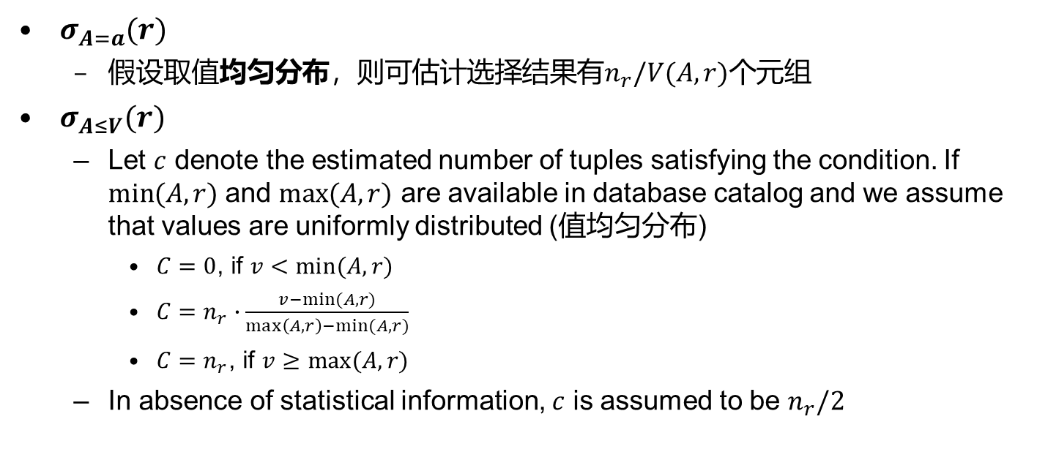
简单选择操作结果大小估计
$σ_{A=a}(r)$
  假设取值均匀分布，则可估计选择结果有$n_{r}/V(A,r)$个元组
$σ_{A≤V}(r)$
  Let $c$ denote the estimated number of tuples satisfying the condition. If $min⁡(A,r)$ and $max⁡(A,r)$ are available in database catalog and we assume that values are uniformly distributed (值均匀分布)
    $C=0$, if $v<min⁡(A,r)$
    $C=n_{r}∙\frac{v−min⁡(A,r)}{\max\left(A,r\right)−min⁡(A,r)}$
    $C=n_{r}$, if $v≥max⁡(A,r)$
  In absence of statistical information, $c$ is assumed to be $n_{r}/2$

Slide 25
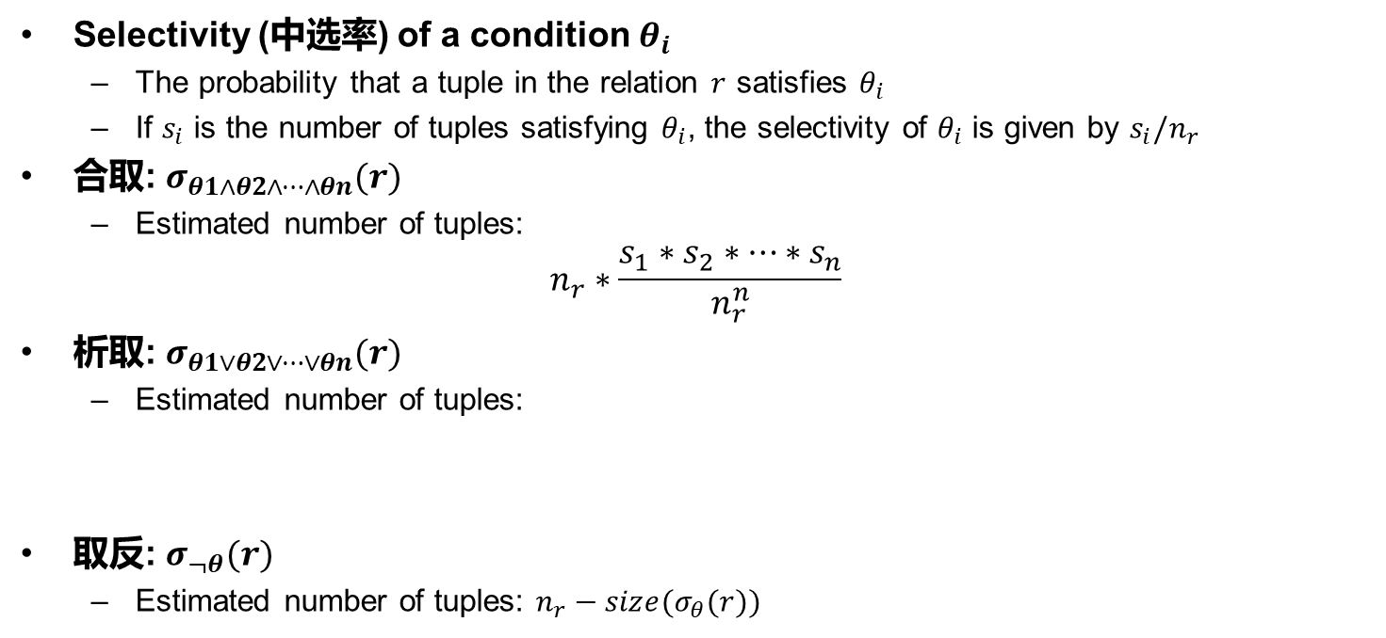
复杂选择操作结果大小估计
Selectivity (中选率) of a condition $θ_{i}$
  The probability that a tuple in the relation $r$ satisfies $θ_{i}$
  If $s_{i}$ is the number of tuples satisfying $θ_{i}$, the selectivity of $θ_{i}$ is given by $s_{i}/n_{r}$
合取: $σ_{θ1∧θ2∧…∧θn}(r)$
  Estimated number of tuples:
$$n_{r}∗\frac{s_{1}∗s_{2}∗…∗s_{n}}{n_{r}^{n}}$$
析取: $σ_{θ1∨θ2∨…∨θn}(r)$
  Estimated number of tuples:
取反: $σ_{¬θ}(r)$
  Estimated number of tuples: $n_{r}−size(σ_{θ}(r))$

Slide 26
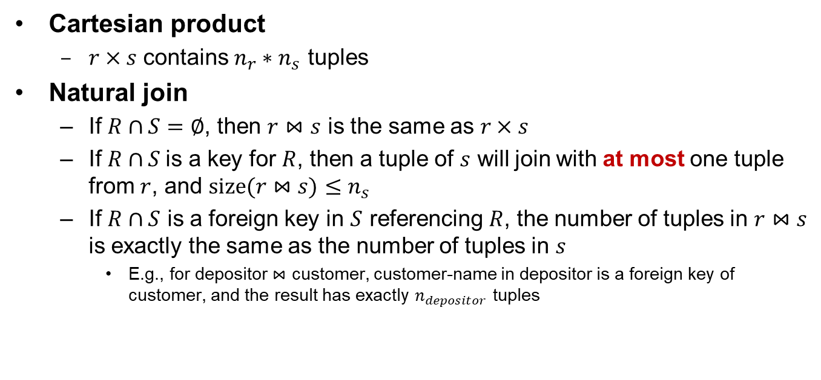
连接操作结果大小估计
Cartesian product
  $r×s$ contains $n_{r}∗n_{s}$ tuples
Natural join
  If $R∩S=∅$, then $r⋈s$ is the same as $r×s$
  If $R∩S$is a key for $R$, then a tuple of $s$ will join with at most one tuple from $r$, and $size(r⋈s)≤n_{s}$
  If $R∩S$ is a foreign key in $S$ referencing $R$, the number of tuples in $r⋈s$ is exactly the same as the number of tuples in $s$
    E.g., for depositor $⋈$ customer, customer-name in depositor is a foreign key of customer, and the result has exactly $n_{depositor}$ tuples
Notes:
If $R∩S=∅$, then $r⋈s$ is the same as $r×s$ ，这是对自然连接的极端情况的解决方案。如果两个关系之间没有共同的属性，而执行natural join，它将返回两个关系的cartesian product。

Slide 27
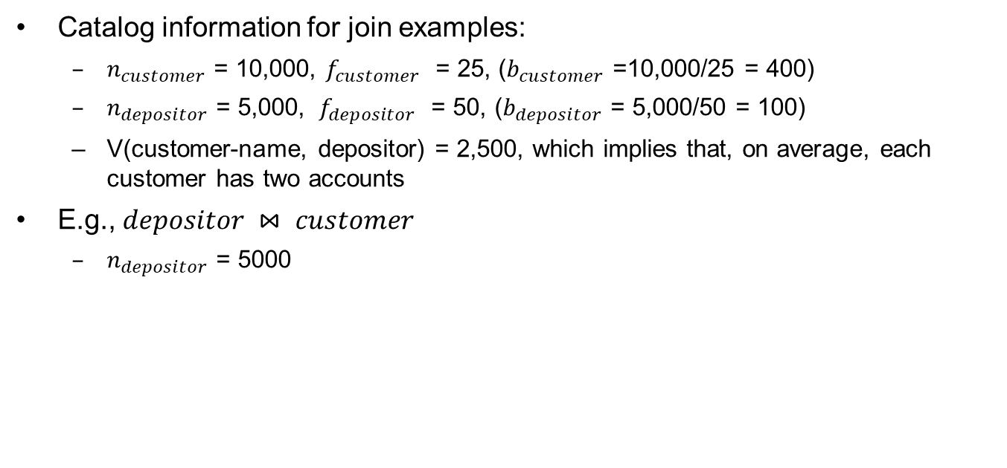
连接操作结果大小估计(续)
Catalog information for join examples:
  $n_{customer}$ = 10,000, $f_{customer}$ = 25, ($b_{customer}$ =10,000/25 = 400)
  $n_{depositor}$ = 5,000, $f_{depositor}$ = 50, ($b_{depositor}$ = 5,000/50 = 100)
  V(customer-name, depositor) = 2,500, which implies that, on average, each customer has two accounts
E.g., $depositor ⋈ customer$
  $n_{depositor}$ = 5000

Slide 28
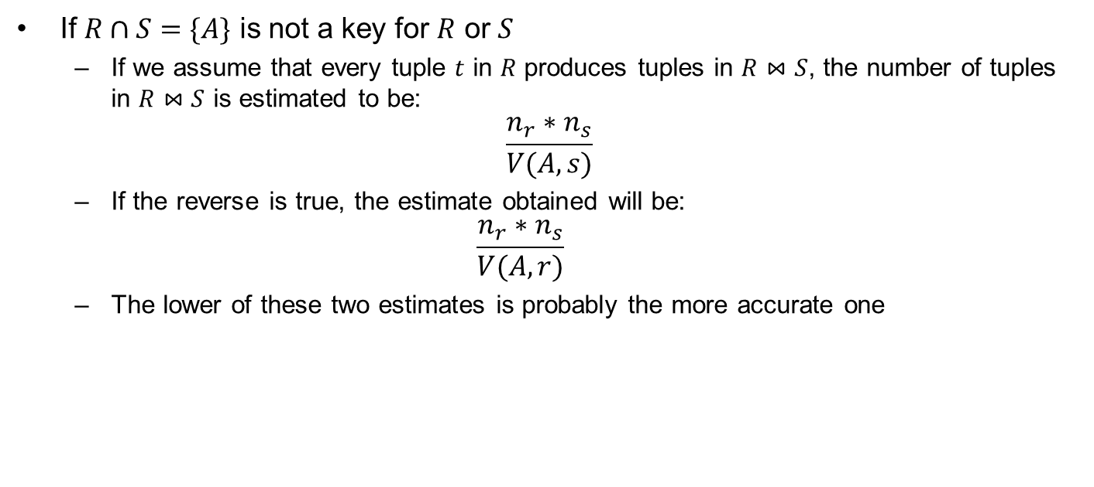
连接操作结果大小估计(续)
If $R∩S=\{A\}$ is not a key for $R$ or $S$
  If we assume that every tuple $t$ in $R$ produces tuples in $R⋈S$, the number of tuples in $R⋈S$ is estimated to be:
$$\frac{n_{r}∗n_{s}}{V(A,s)}$$
  If the reverse is true, the estimate obtained will be:
  $$\frac{n_{r}∗n_{s}}{V(A,r)}$$
  The lower of these two estimates is probably the more accurate one

Slide 29
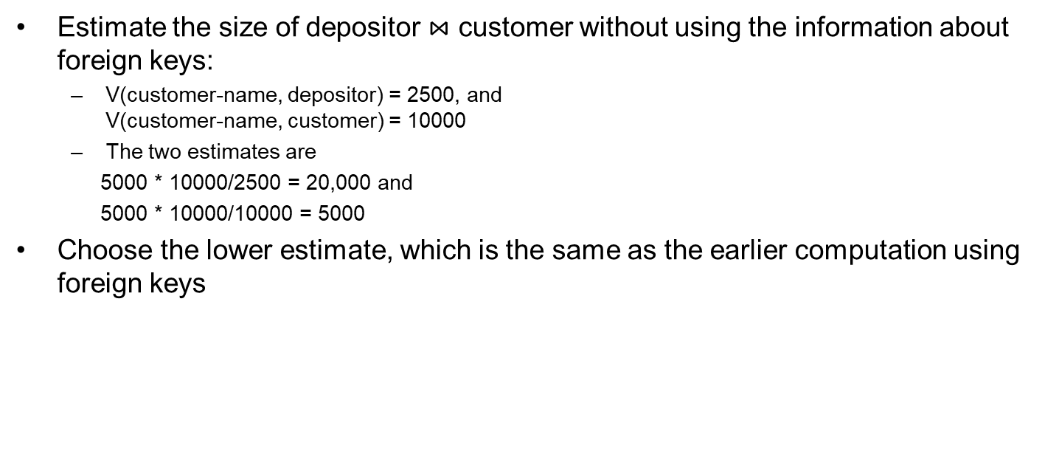
连接操作结果大小估计(续)
Estimate the size of depositor $⋈$ customer without using the information about foreign keys:
  V(customer-name, depositor) = 2500, and
  V(customer-name, customer) = 10000
  The two estimates are
  5000 * 10000/2500 = 20,000 and
  5000 * 10000/10000 = 5000
Choose the lower estimate, which is the same as the earlier computation using foreign keys

Slide 30
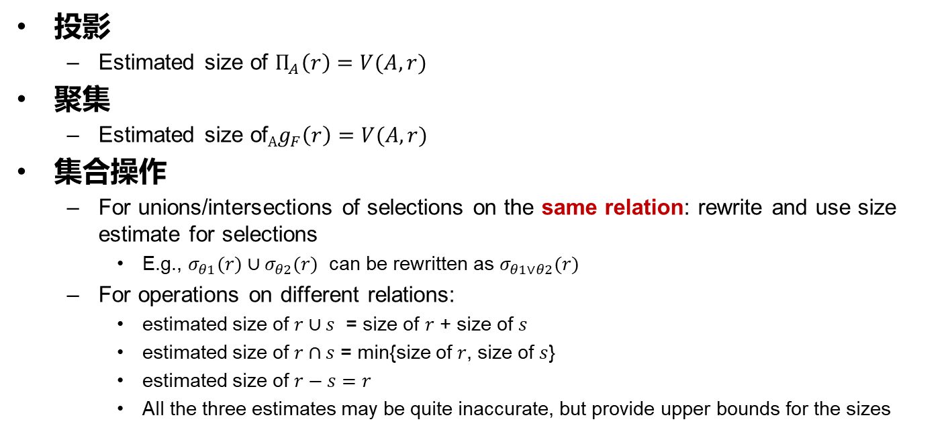
其他操作结果集大小估计
投影
  Estimated size of $Π_{A}\left(r\right)=V(A,r)$
聚集
  Estimated size of${Ag}_{F}\left(r\right)=V(A,r)$
集合操作
  For unions/intersections of selections on the same relation: rewrite and use size estimate for selections
    E.g., $σ_{θ1}(r)∪σ_{θ2}(r)$ can be rewritten as $σ_{θ1∨θ2}(r)$
  For operations on different relations:
    estimated size of $r∪s$ = size of $r$ + size of $s$
    estimated size of $r∩s$ = min{size of $r$, size of $s$}
    estimated size of $r−s=r$
    All the three estimates may be quite inaccurate, but provide upper bounds for the sizes

Slide 31

其他操作结果集大小估计（续）
Outer join
  Estimated size of $r s$ = size of $r⋈s$ + size of $r$
    Case of right outer join is symmetric
  Estimated size of $r s$ = size of $r⋈s$ + size of $r$ + size of $s$

Slide 32
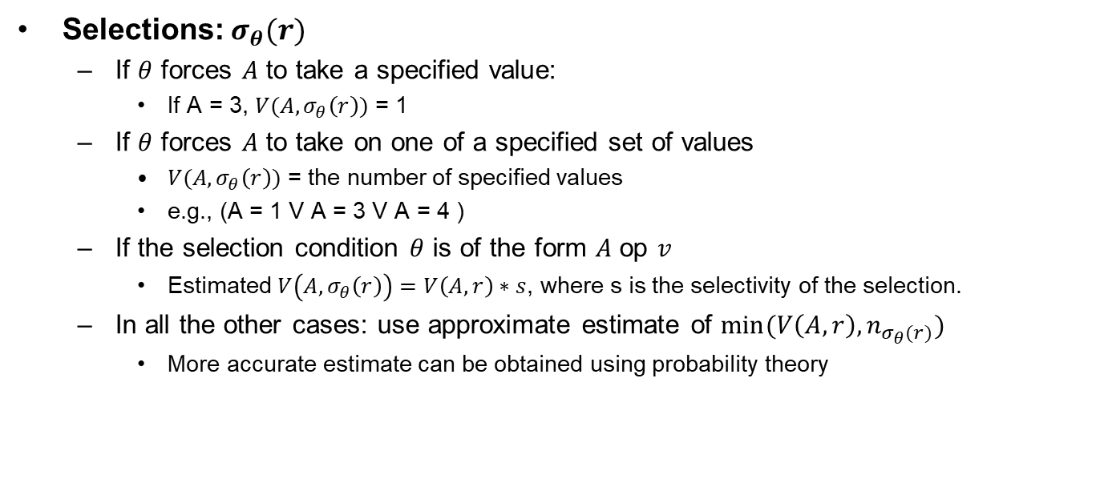
Estimation of Distinct Values
Selections: $σ_{θ}(r)$
  If $θ$ forces $A$ to take a specified value:
    If A = 3, $V(A,σ_{θ}\left(r\right))$ = 1
  If $θ$ forces $A$ to take on one of a specified set of values
    $V(A,σ_{θ}\left(r\right))$ = the number of specified values
    e.g., (A = 1 V A = 3 V A = 4 )
  If the selection condition $θ$ is of the form $A$ op $v$
    Estimated $V\left(A,σ_{θ}\left(r\right)\right)=V\left(A,r\right)∗s$, where s is the selectivity of the selection.
  In all the other cases: use approximate estimate of $min⁡(V\left(A,r\right),n_{σ_{θ}(r)})$
    More accurate estimate can be obtained using probability theory

Slide 33
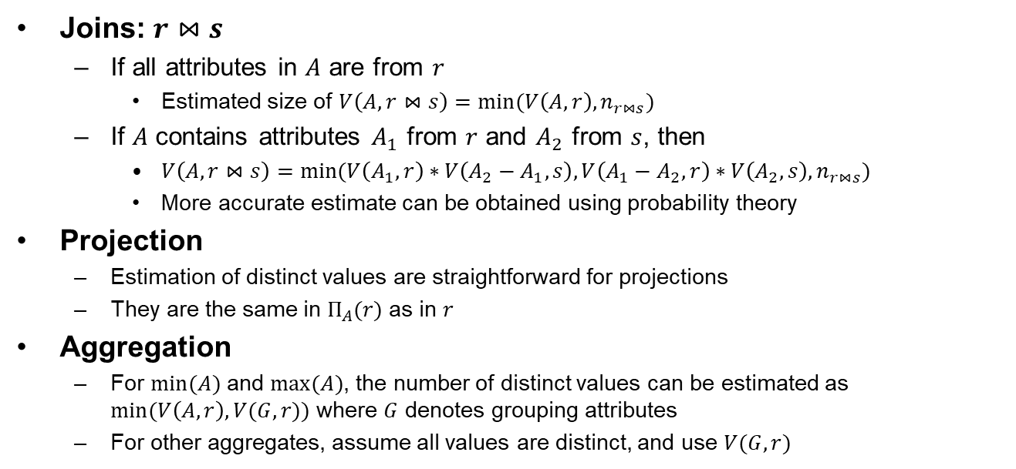
Estimation of Distinct Values (Cont.)
Joins: $r⋈s$
  If all attributes in $A$ are from $r$
    Estimated size of $V\left(A,r⋈s\right)=min⁡(V\left(A,r\right),n_{r⋈s})$
  If $A$ contains attributes $A_{1}$ from $r$ and $A_{2}$ from $s$, then
    $V\left(A,r⋈s\right)=min⁡(V\left(A_{1},r\right)∗V\left(A_{2}−A_{1},s\right),V\left(A_{1}−A_{2},r\right)∗V\left(A_{2},s\right),n_{r⋈s})$
    More accurate estimate can be obtained using probability theory
Projection
  Estimation of distinct values are straightforward for projections
  They are the same in $Π_{A}(r)$ as in $r$
Aggregation
  For $min⁡(A)$ and $max⁡(A)$, the number of distinct values can be estimated as $min⁡(V\left(A,r\right),V(G,r))$ where $G$ denotes grouping attributes
  For other aggregates, assume all values are distinct, and use $V(G,r)$

Slide 34
Outline
概述
关系表达式的转换
表达式执行代价估计
执行计划选择
物化视图*
查询优化中的高级话题*

Slide 35
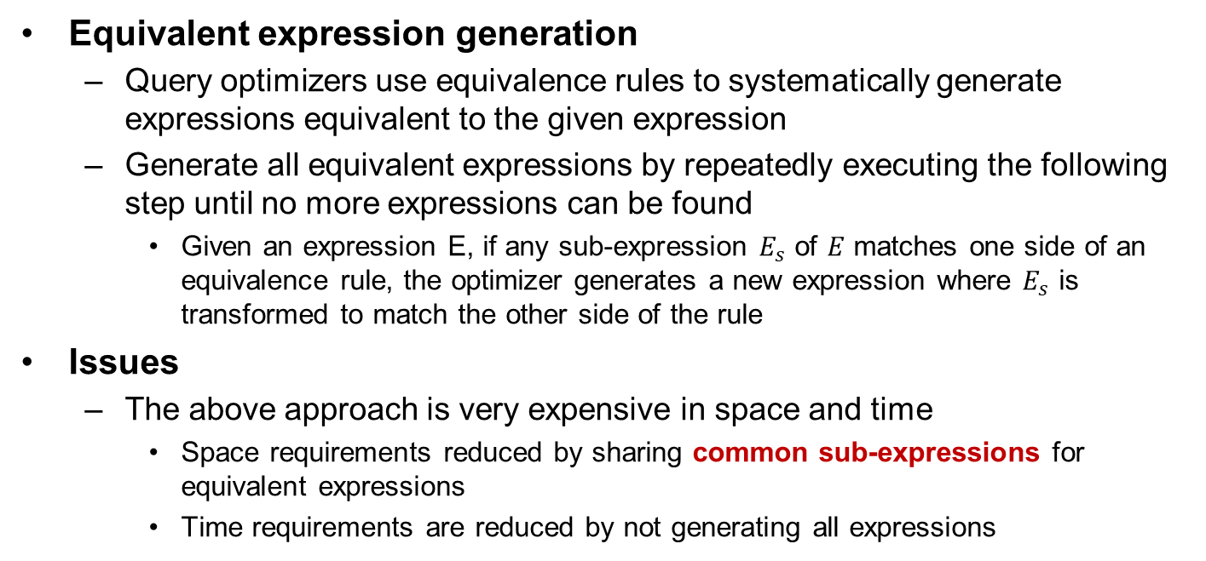
Enumeration of Equivalent Expressions
Equivalent expression generation
  Query optimizers use equivalence rules to systematically generate expressions equivalent to the given expression
  Generate all equivalent expressions by repeatedly executing the following step until no more expressions can be found
    Given an expression E, if any sub-expression $E_{s}$ of $E$ matches one side of an equivalence rule, the optimizer generates a new expression where $E_{s}$ is transformed to match the other side of the rule
Issues
  The above approach is very expensive in space and time
    Space requirements reduced by sharing common sub-expressions for equivalent expressions
    Time requirements are reduced by not generating all expressions

Slide 36
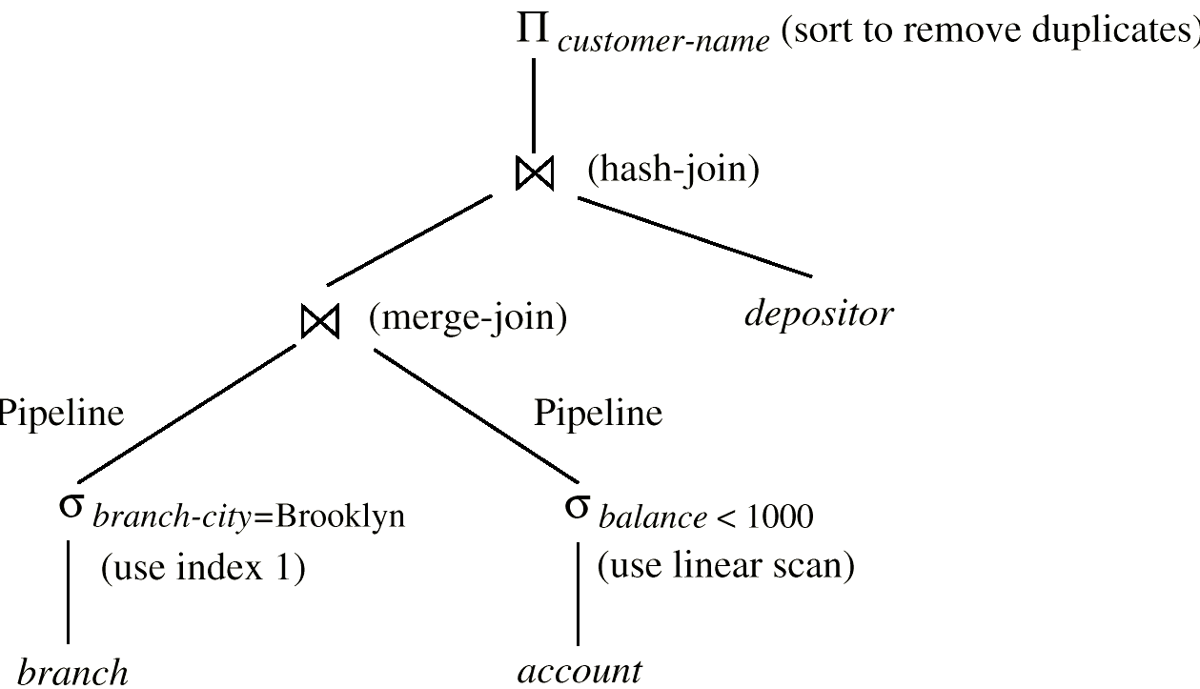
Execution Plan
An execution plan defines exactly what algorithm is used for each operation, and how the execution of the operations is coordinated

Slide 37
Choice of Execution Plans
Two general approaches
  Search all the plans and choose the best plan in a cost-based fashion
  Uses heuristics to choose a plan
Interaction of evaluation operations
  Choosing the cheapest algorithm for each operation independently may not yield the best overall algorithm
    merge-join may be costlier than hash-join, but may provide a sorted output which reduces the cost for an outer level aggregation
    nested-loop join may provide opportunity for pipelining

Slide 38
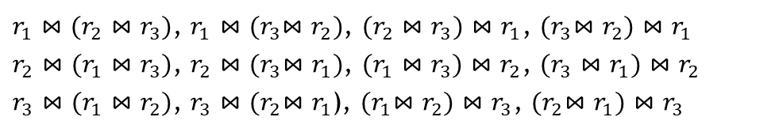
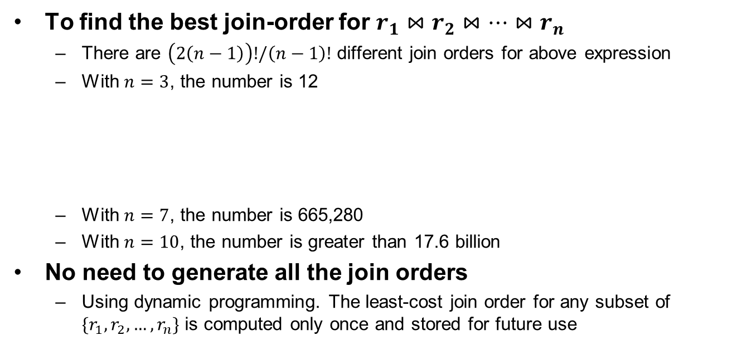
Cost-based Optimization
To find the best join-order for $r_{1}⋈r_{2}⋈…{⋈r}_{n}$
  There are $\left(2\left(n−1\right)\right)!/\left(n−1\right)!$ different join orders for above expression
  With $n=3$, the number is 12
  With $n=7$, the number is 665,280
  With $n=10$, the number is greater than 17.6 billion
No need to generate all the join orders
  Using dynamic programming. The least-cost join order for any subset of $\{r_{1},r_{2},…,r_{n}\}$ is computed only once and stored for future use
$r_{1}⋈(r_{2}⋈r_{3})$, $r_{1}⋈{(r}_{3}⋈r_{2})$, $(r_{2}⋈r_{3})⋈r_{1}$, ${(r}_{3}⋈r_{2})⋈r_{1}$
$r_{2}⋈(r_{1}⋈r_{3})$, $r_{2}⋈{(r}_{3}⋈r_{1})$, $(r_{1}⋈r_{3})⋈r_{2}$, $(r_{3}⋈r_{1})⋈r_{2}$
$r_{3}⋈(r_{1}⋈r_{2})$, $r_{3}⋈{(r}_{2}⋈r_{1}$), ${(r}_{1}⋈r_{2})⋈r_{3}$, ${(r}_{2}⋈r_{1})⋈r_{3}$

Slide 39
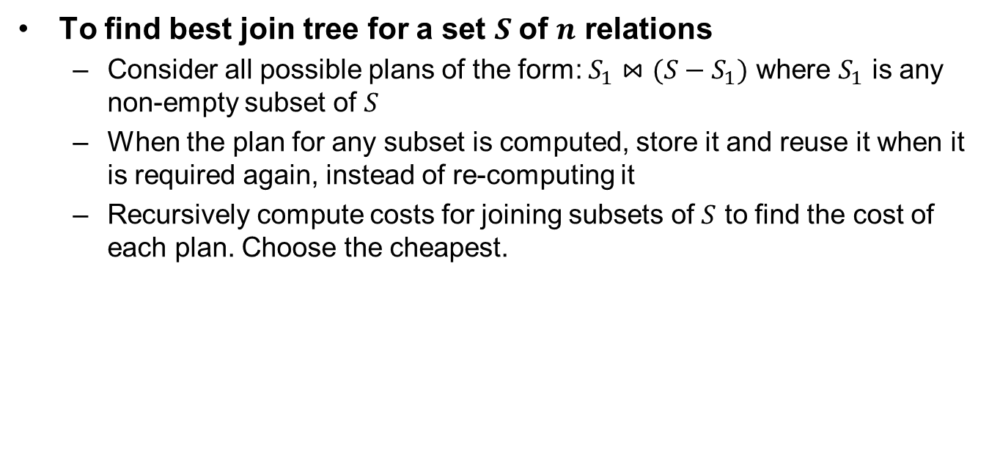
Dynamic Programming in Optimization
To find best join tree for a set $S$of $n$ relations
  Consider all possible plans of the form: $S_{1}⋈(S−S_{1})$ where $S_{1}$ is any non-empty subset of $S$
  When the plan for any subset is computed, store it and reuse it when it is required again, instead of re-computing it
  Recursively compute costs for joining subsets of $S$ to find the cost of each plan. Choose the cheapest.

Slide 40
Join Order Optimization Algorithm
procedure findbestplan(S)
if (bestplan[S].cost ≠ ∞)
return bestplan[S]
if (S contains only 1 relation)
set bestplan[S].plan and bestplan[S].cost
based on best way of accessing S
else for each non-empty subset S1 of S such that S1 ≠ S
P1= findbestplan(S1)
P2= findbestplan(S - S1)
A = best algorithm for joining results of P1 and P2
cost = P1.cost + P2.cost + cost of A
if cost < bestplan[S].cost
bestplan[S].cost = cost
bestplan[S].plan = “execute P1.plan;
execute P2.plan;
join results of P1 and P2 using A”
return bestplan[S]
Dynamic-programming algorithm

Slide 41
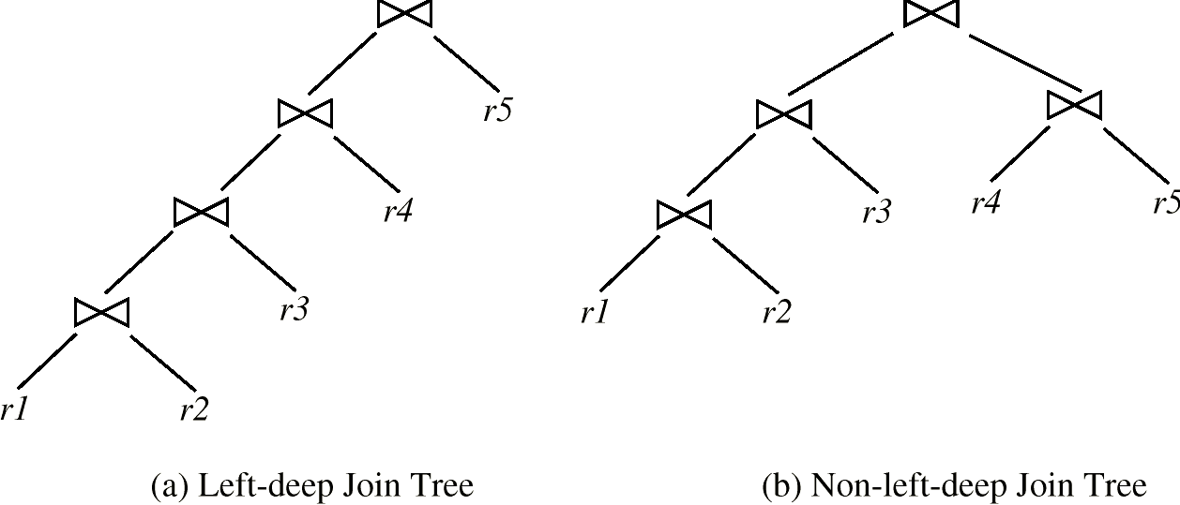
Left Deep Join Trees
In left-deep join trees, the right-hand-side input for each join is a relation, not the result of an intermediate join

Slide 42
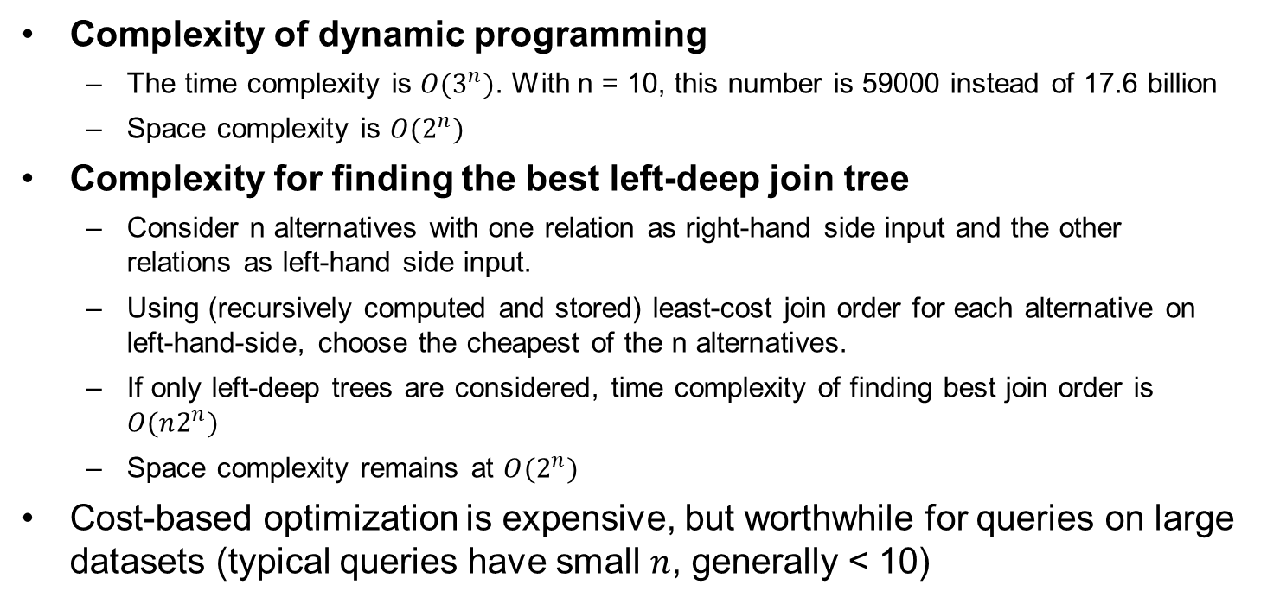
Cost of Optimization
Complexity of dynamic programming
  The time complexity is $O(3^{n})$. With n = 10, this number is 59000 instead of 17.6 billion
  Space complexity is $O(2^{n})$
Complexity for finding the best left-deep join tree
  Consider n alternatives with one relation as right-hand side input and the other relations as left-hand side input.
  Using (recursively computed and stored) least-cost join order for each alternative on left-hand-side, choose the cheapest of the n alternatives.
  If only left-deep trees are considered, time complexity of finding best join order is $O(n2^{n})$
  Space complexity remains at $O(2^{n})$
Cost-based optimization is expensive, but worthwhile for queries on large datasets (typical queries have small $n$, generally < 10)

Slide 43
Heuristic Optimization
Cost-based optimization is expensive, even with dynamic programming
Systems may use heuristics to reduce the number of choices that must be made in a cost-based fashion
Heuristic optimization transforms the query-tree by using a set of rules that typically (but not in all cases) improve execution performance:
  Perform selection early (reduce the number of tuples)
  Perform projection early (reduce the number of attributes)
  Perform most restrictive selection and join operations before other similar operations
  Some systems use only heuristics, others combine heuristics with partial cost-based optimization

Slide 44
Steps in Typical Heuristic Optimization
Deconstruct conjunctive selections into a sequence of single selection operations (Equiv. rule 1.)
Move selection operations down the query tree for the earliest possible execution (Equiv. rules 2, 7a, 7b, 11)
Execute first those selection and join operations that will produce the smallest relations (Equiv. rule 6)
Replace Cartesian product operations that are followed by a selection condition by join operations (Equiv. rule 4a)
Deconstruct and move as far down the tree as possible the lists of projection attributes, creating new projections where needed (Equiv. rules 3, 8a, 8b, 12)
Identify those subtrees whose operations can be pipelined, and execute them using pipelining
Notes:
Conjunctive：合取

Slide 45
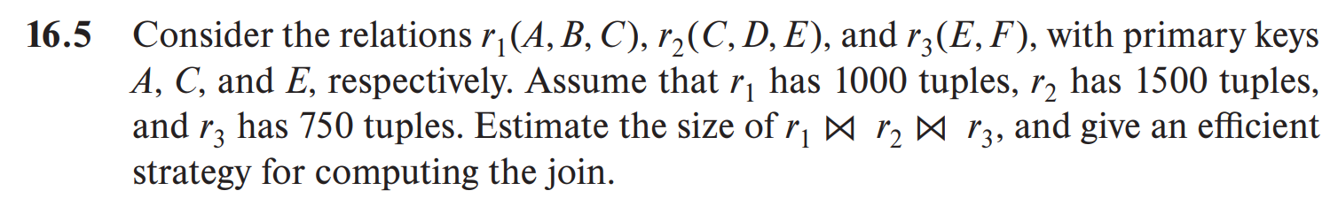
Assignment
16.5 (第7版)
  Canvas上提交，单个PDF文件

Slide 46
End of Chapter 16

